Slide 1
Book Recommendation System
Mr. A. T. Atul
Mr. Shivanand Magnum
Mr. Srinidhi Pranesh Kulkarni
R. Shubham Sanja Mahajan
Ms. R. Sujatha
Mr. Ahmed Firoz Sayed

Slide 2
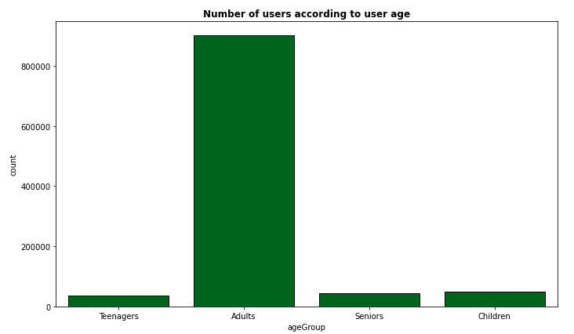
Classification of Age Groups
Children : 1 - 12
Teenager : 13 - 19
Adults : 20 - 60
Seniors : 60 +

Slide 3
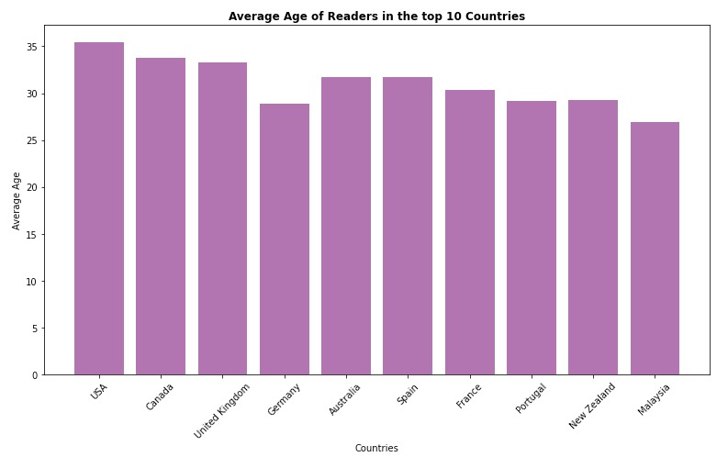
Average Age of Readers
31 is the Average Age of Readers in the top 10 Countries
34 is the Overall Average Age of the Readers

Slide 4
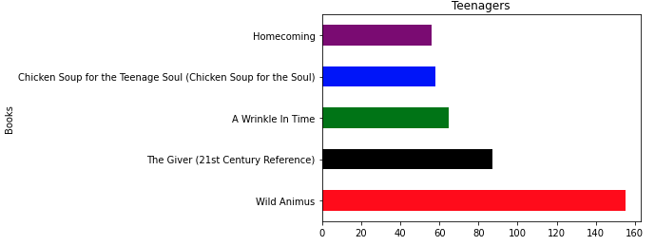
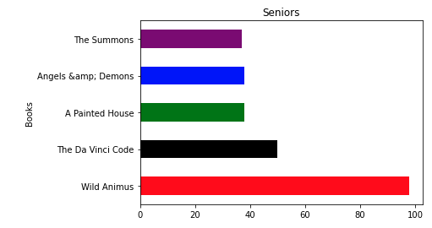
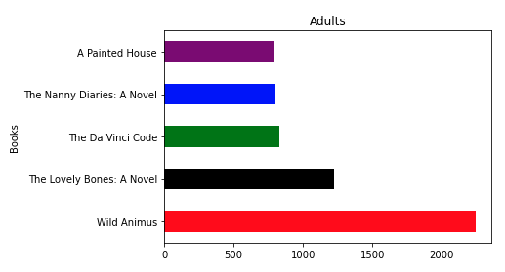
Most Read Books Among the Age Groups

Slide 5
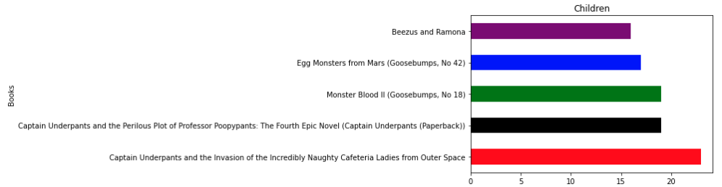
Most read Books Among Children

Slide 6
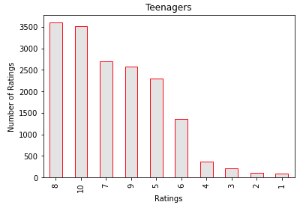
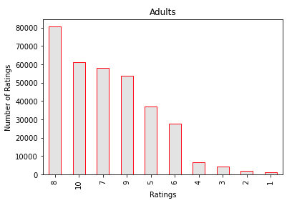
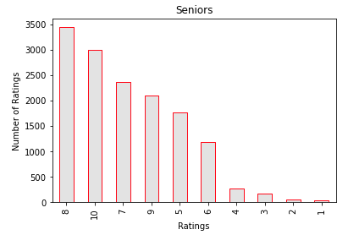
Age Group and their Ratings

Slide 7
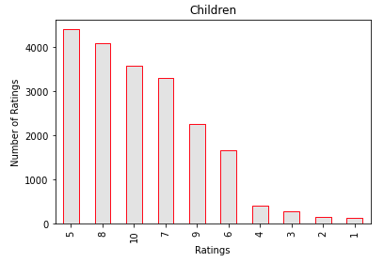
Age Group and their Ratings
Storia Del Cinema Italiano
The Best American Short Stories
The Encounter

Slide 8
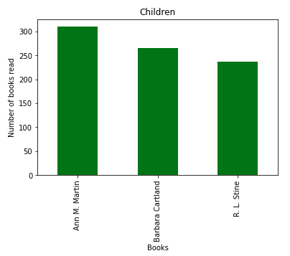
Most Read Authors of Children
Ann M. Martin : Karen’s Little Sister
Barbara Cartland : Pure and Untouched
R.L.Stine: Monster Blood II

Slide 9
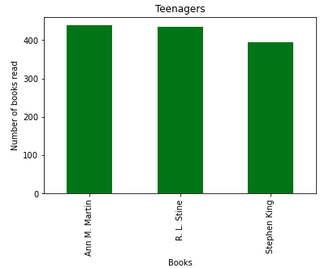
Most Read Authors of Teenagers
Ann. M. Martin: Karen’s Roller Skates
Stephen King: Misery
R. L. Stine : Welcome to Dead House

Slide 10
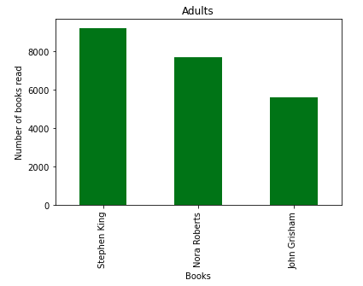
Most Read Authors of Adult
Stephen King: Dreamcatcher
Nora Roberts: The Villa
John Grisham : A Painted House

Slide 11
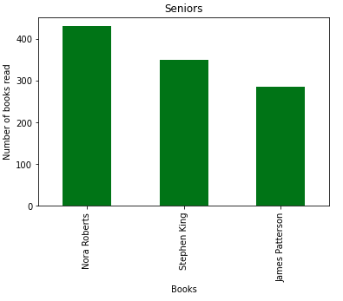
Most Read Authors of Seniors
Note Roberts: Carolina Moon
Stephen King: Dream Catcher
James Patterson : When the Wind Blows

Slide 12
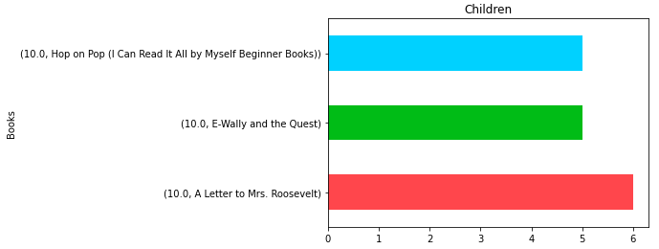
Highly Rated Book of Children

Slide 13
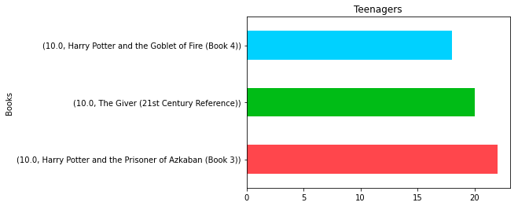
Highly Rated Books of Teenagers
Note : Out of all Age Groups, Teenagers shared more number of Ratings

Slide 14
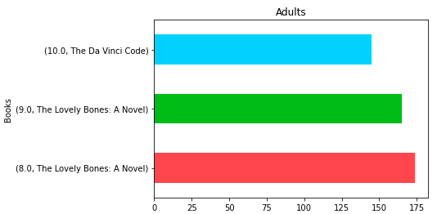
Highly Rated Books of Adults

Slide 15
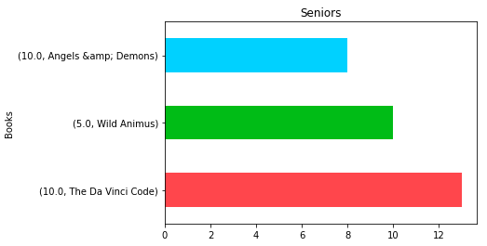
Highly Rated Book of Seniors

Slide 16

Top 10 Countries
USA
Canada
UK
Germany
Australia
Spain
France
Portugal
New Zealand
Malaysia

Slide 17

Most Popular Books in USA
Wild Animus
The Lovely Bones : A Novel
The Da Vinci Code
A Painted House
The Secret Life of Bees

Slide 18

Most Popular Books in Canada
Wild Animus
The Lovely Bones : A Novel
The Pelican Brief
She’s Come Undone
The Summons

Slide 19

Most Popular Books in UK
Wild Animus
Bridget Jone’s Diary
Chocolat
Memoirs of a Geisha UK
Dead Famous

Slide 20

Most Popular Books in Germany
Wild Animus
Russendisko
Stupid White Maen
Illuminati
Der Vorleser

Slide 21

Most Popular Books in Australia
Wild Animus
Memoirs of a Geisha UK
Chocolat
Bridget Jone’s Diary
The Lovely Bones : A Novel

Slide 22
Models
Popularity based approach
Item-Item based collaborative filtering
User based collaborative

Slide 23
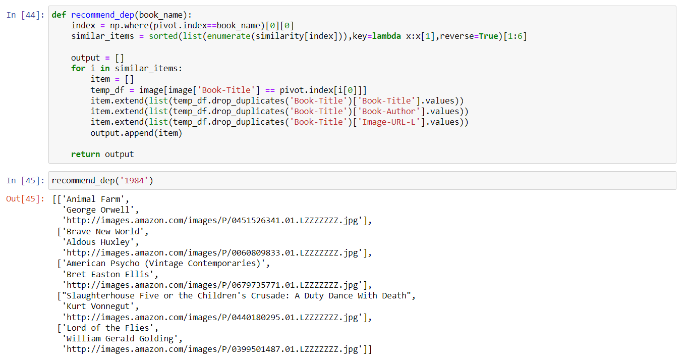
Item based model

Slide 24
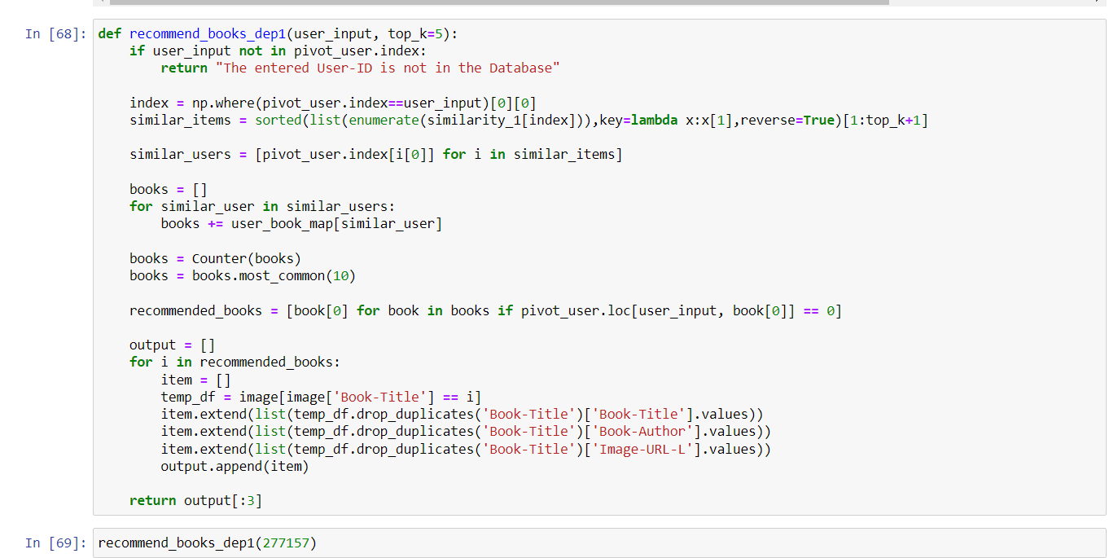
User based model

Slide 25
Evaluation
Out of 50 books our model predicted 34 already read
By the entered user id’s which is giving 68% accuracy.

Slide 26
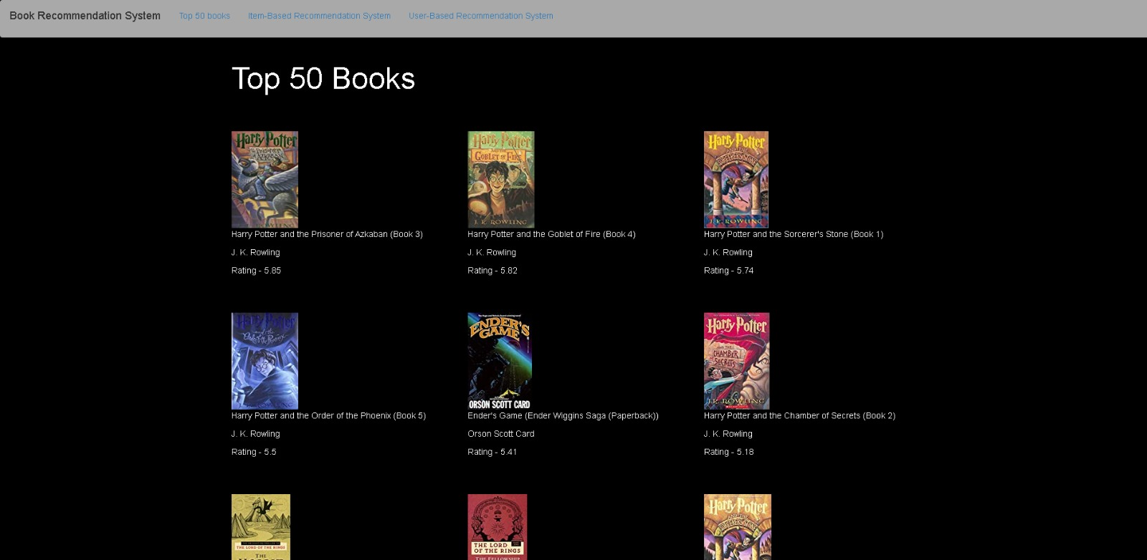
Using Popularity Based Approach to display top 50 books from the Dataset

Slide 27
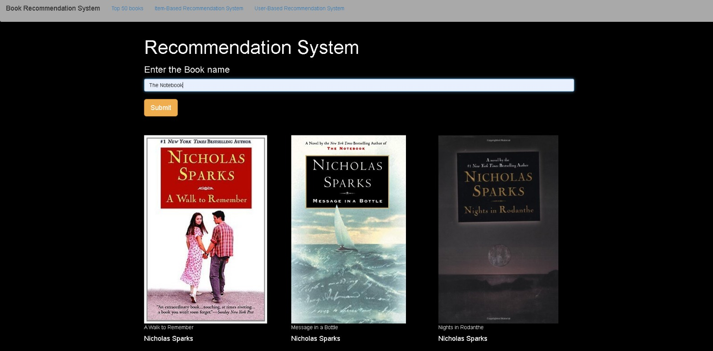
Item-Item Based Collaborative Filtering

Slide 28
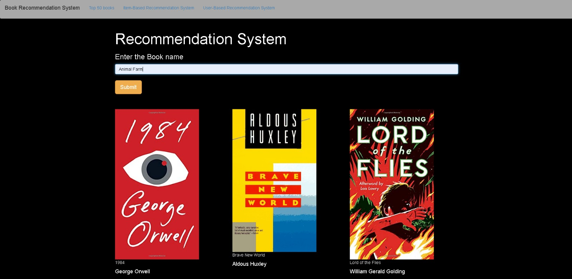

Slide 29
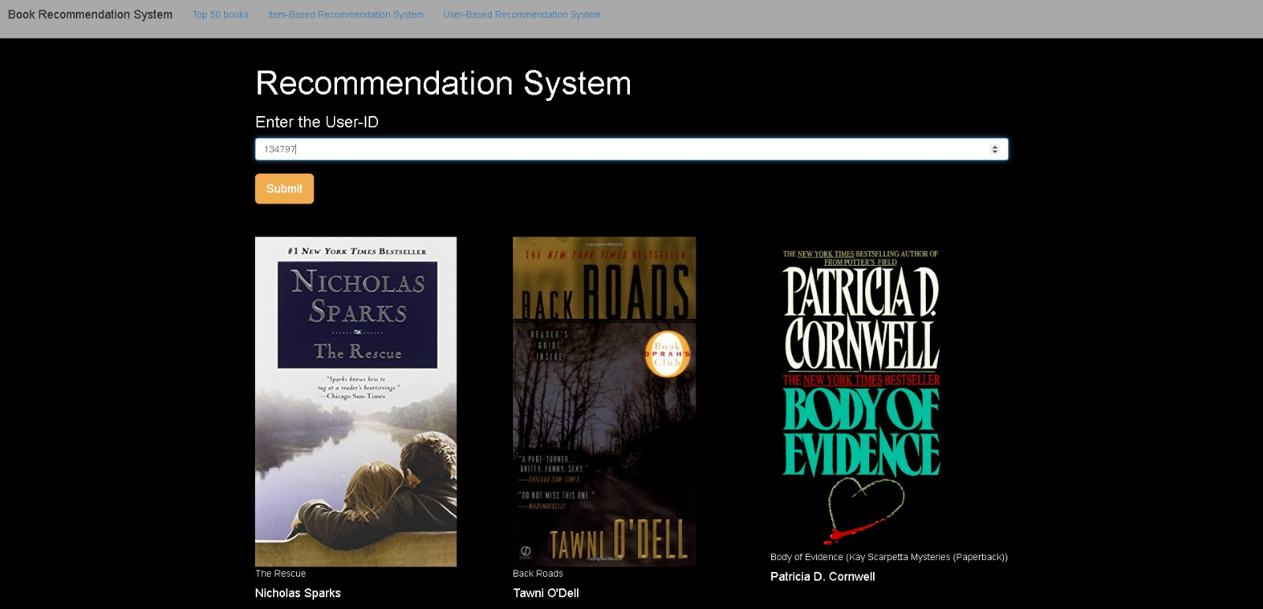
User-Based collaborative

Slide 30
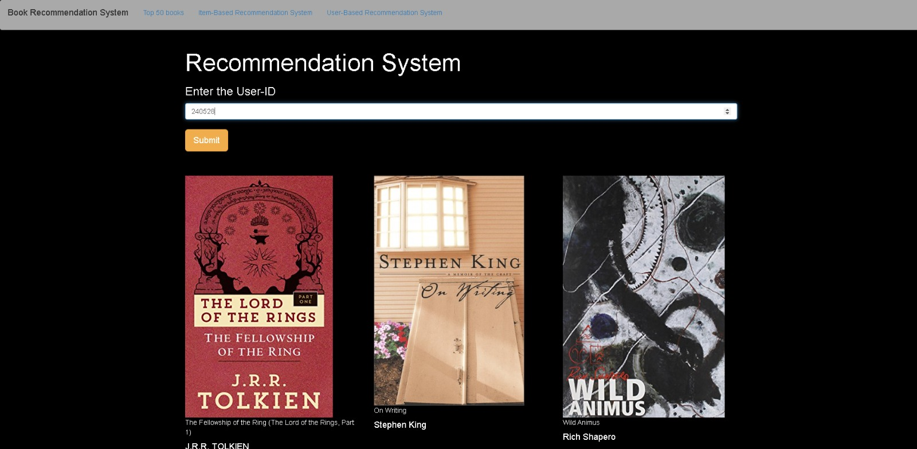

Slide 31
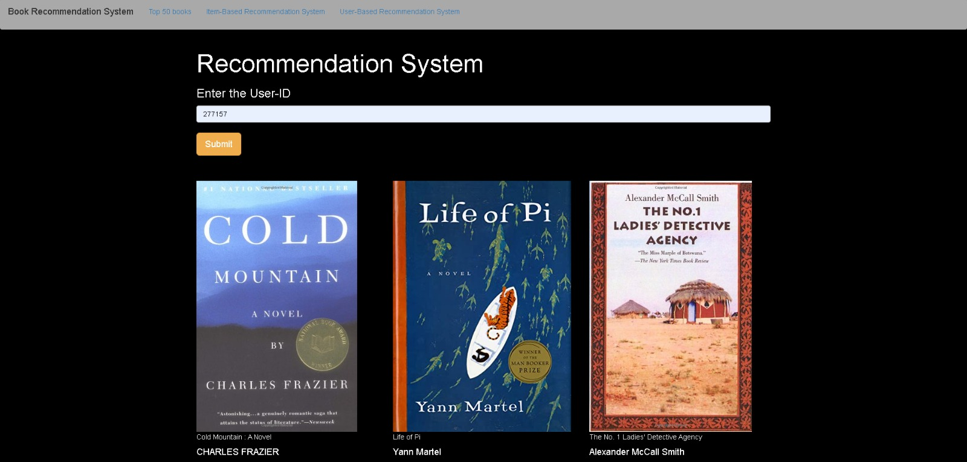

Slide 32
Thank You

